Slide 1
Midland Energy: Cost of Capital
Jake Baron, Ben Hoffman, Reid Zuerlein, Lucas Lantis

Slide 2
How is the WACC used at Midland Energy Resources?
Used to compare new ventures to Midland’s general operations
Estimates are being used in the decision-making process:
  Accounting and capital budgeting
  mergers and acquisitions
  performance reviews
  stock repurchase agreements
Mortensen’s calculation used widely throughout the organization. Therefore,
  Inputs should be as inclusive as possible to include all facets of operation

Slide 3
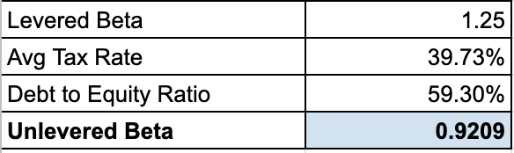
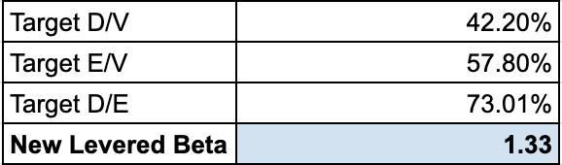
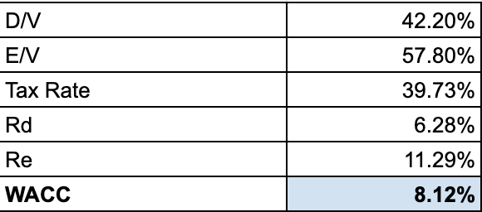
Corporate WACC Calculation
Calculated the average tax rate of the 3 years given
  39.73%
Next we found the unlevered beta using the tax rate and debt to equity ratio
Then we calculated the new levered beta using the target debt to equity ratio of 73.01%
Found the cost of equity and debt based on the 10 yr T-Bill rate of 4.66% and EMRP of 5%
Using these rates we computed the corporate WACC of 8.12%

Slide 4
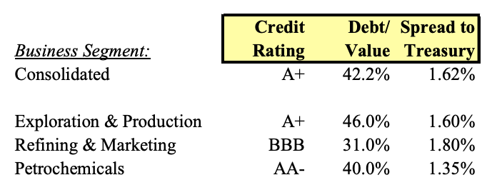
Corporate Hurdle Rate
Midland should not use a universal hurdle rate for all divisions of the company because each division has different risks.
The Exploration and Production division has high margins on high capital investments but low revenues. The division is relatively low risk.
The Refining and Marketing Division relies on high revenues for small margins and could experience high risk.
E&P has an A+ credit rating while R&M has a BBB credit rating signifying different risks the credit market has assigned the divisions.

Slide 5
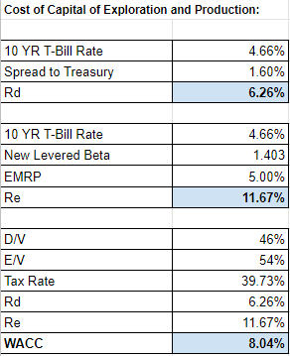
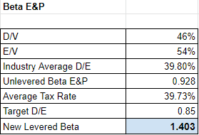
WACC: E&P
Used given information to calculate “Rd”
Calculated the new levered beta to find “Re”
  Found target D/E ratio by taking D/V divided by E/V
  Unlevered the industry average equity beta of 1.15
  Used levered beta formula to calculate “New Levered Beta”
  EMRP and 10 YR rate given
Finally, calculated E&P WACC of 8.04%

Slide 6
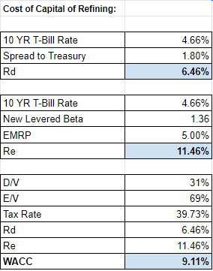
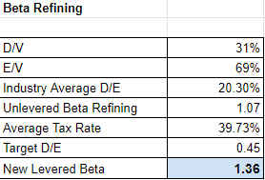
WACC: Refining & Marketing
Used given information to calculate “Rd”
Calculated the new levered beta to find “Re”
  Found target D/E ratio by taking D/V divided by E/V
  Unlevered the industry average equity beta of 1.20
  Used levered beta formula to calculate “New Levered Beta”
  EMRP and 10 YR rate given
Finally, calculated Refining WACC of 8.04%

Slide 7
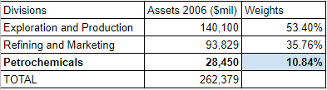
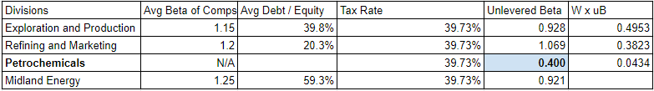
WACC: Petrochemicals
Need to find certain inputs to complete the WACC calculation
Levered beta for the Petrochemical division
  Calculated asset values from given weights
  Calculated unlevered betas from comparable company divisions
  Solved for unknown, which is the Petrochemical unlevered beta

Slide 8

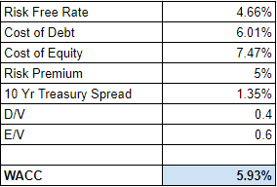
WACC: Petrochemicals cont.
Using the unlevered beta if 0.561, we calculated a levered beta for the Petrochemical division
  Now had all components for the final WACC formula
  RF Rate: 10-yr Treasury bond rate of 4.66%
  EMRP: 5%
  R(e): RF + Beta * EMRP = 7.46%
  R(d): RF + Treasury Spread = 6.01%
  D/V = 0.4
  E/V = 1 - D/V = 0.6
Petrochemical WACC = 5.93%

